Slide 1
Evaluation

Slide 2
Measure for search engine
How fast does it index?
Number of documents/hour
Incremental indexing –adds 10K products/day
How fast does it search?
Latency and CPU needs for 5 million products
Expressiveness of query language
Ability to express complex information needs
Speed on complex queries
Does it recommend related products?
Uncluttered UI
Is it free
You want users to be happy with the search experience

Slide 3
Measure for search engine
All the preceding criteria are measurable: we can quantify speed/size
We can make expressiveness precise
The key measure: User happiness
Speed of response/size of index are factors
But blindingly fast, useless answers won't make a user happy
Need a way of quantifying user happiness

Slide 4
User Happiness
Web Engine: Search returns products relevant to users
How do you assess this at scale?
Search results get clicked a lot
Misleading titles/summaries can cause users to click
users spend a lot of time after using the search engine
E-commerce website: Users buy after using the search engine
Repeat visitors/buyers
Do users leave soon after searching?
Do they come back within a week/month/… ?
Enterprise (company/govt/academic): care about user productivity
How much time do my user save when looking for information
Many other criteria having to do with breadth of access, secure access etc.

Slide 5
Happiness: elusive to measure
Most common proxy: relevance of search results
But how do you measure relevance?
Three elements:
A benchmark document collection
A benchmark suite of queries
An assessment of either Relevant or Nonrelevant for each query and each document

Slide 6
So you want to measure the quality of a new search algorithm?
Benchmark documents – nozama’s products
Benchmark query suite – more on this
Judgments of document relevance for each query
5 million nozama.com products
Relevance
judgment
50000
sample
queries

Slide 7
Relevance judgments
Binary (relevant vs. non-relevant) in the simplest case
More nuanced relevance levels also used(0, 1, 2, 3 …)
What are some issues already?
5 million times 50K takes us into the range of a quarter trillion judgments
If each judgment took a human 2.5 seconds, we’d still need 10¹¹ seconds, or nearly $300 million if you pay people $10 per hour to assess
10K new products per day

Slide 8
Crowd source relevance judgments?
Present query-document pairs to low-cost labor on online crowd-sourcing platforms
Hope that this is cheaper than hiring qualified assessors
Lots of literature on using crowd-sourcing for such tasks
You get fairly good signal, but the variance in the resulting judgments is quite high

Slide 9
What else?
Still need test queries
Must be relevant to docs available
Must be representative of actual user needs
Random query terms from the documents are not a good idea
Sample from query logs if available

Slide 10
Now we have the basics of a benchmark
Let’s review some evaluation measures
Precision
Recall
DCG
…

Slide 11
Evaluating an IR system
Sec. 8.1
Note: user need is translated into a query
Relevance is assessed relative to the user need, not the query
E.g., Information need: My swimming pool bottom is becoming black and needs to be cleaned.
Query: pool cleaner
Assess whether the doc addresses the underlying need, not whether it has these words

Slide 12
Standard Relevance Benchmarks
TREC: National Institute of Standards and Technology (NIST) has run a large IR test bed for many years
Reuters and other benchmark doc collections used
“Retrieval tasks” specified
Sometimes as query
Human expert mark, for each query and for each doc, relevant or non relevant
Or at least for subset of docs that some system returned for that query

Slide 13
Unranked retrieval evaluation: Precision and Recall
Sec. 8.3
Binary assessments
Precision: fraction of retrieved docs that are relevant =
P(relevant returned|total retrieved)
Recall: fraction of relevant docs that are retrieved= P(relevant returned|total relevant)
Precision P = tp/(tp + fp)
Recall R = tp/(tp + fn)
 | Relevant | Nonrelevant
Retrieved | tp | fp
Not Retrieved | fn | tn

Slide 14
Should we instead use the accuracy measure for evaluation?
Given a query, an engine classifies each docs as “relevant” or “non relevant”
The accuracy of an engine: the fraction of these classifications that are correct
(tp+tn)/(tp+tn+fp+fn)
Accuracy is a commonly used evaluation measure in machine learning classification work
Why is this not a very useful evaluation measure in IR?

Slide 15
Precision/Recall
Recall is a non-decreasing function of the number of docs retrieved
In a good system, precision decreases as either the number of docs retrieved or recall increases

Slide 16
Example
An IR system returns 8 relevant documents, and 10 nonrelevant documents. There are a total of 20 relevant documents in the collection. What is the precision of the system on this search, and what is its recall?

Slide 17
Difficulties in using Precision/Recall
Should average over large document collection/query ensembles
Need human relevance assessment
People are not reliable assessor
Assessment have to be binary

Slide 18
A combined measure: F-score
Combined measure that assess precision/recall tradeoff is F-measure (weighted harmonic mean)
F= ((β^2)+1)PR/((β^2)(P+R))
People usually use balanced F1 measure
i.e. with beta=1
Harmonic mean is a conservative average

Slide 19
Rank-Based Measures
Binary relevance
Precision@K (P@K)
Mean Average Precision (MAP)
Mean Reciprocal Rank (MRR)
Multiple levels of relevance
Normalized Discounted Cumulative Gain (NDCG)

Slide 20

Precision@K
Set a rank threshold K
Compute % relevant in top K
Ignores documents ranked lower than K
Ex:
Prec@3 of 2/3
Prec@4 of 2/4
Prec@5 of 3/5
In similar fashion we have Recall@K

Slide 21

Mean Average Precision
Consider rank position of each relevant doc
K₁, K₂, … K_{R}
Compute Precision@K for each K₁, K₂, … K_{R}
Average precision = average of P@K
Ex: has AvgPrec of
MAP is Average Precision across multiple queries/rankings

Slide 22
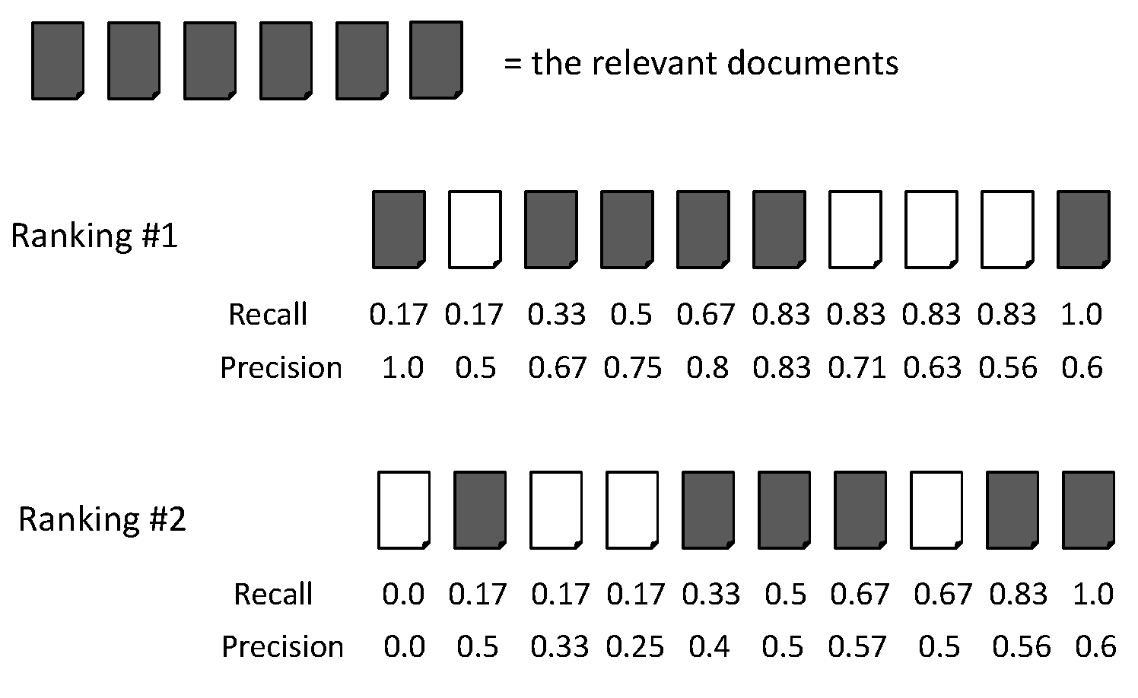
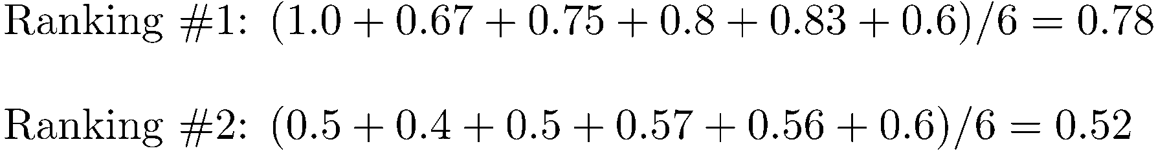
Average Precision

Slide 23
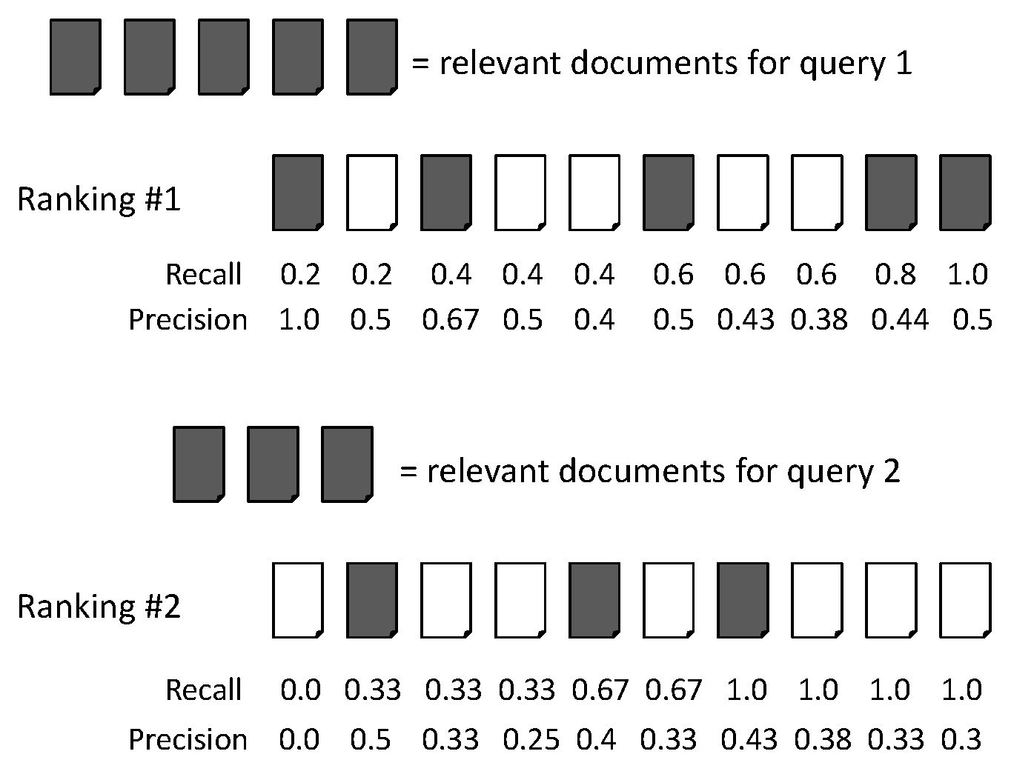
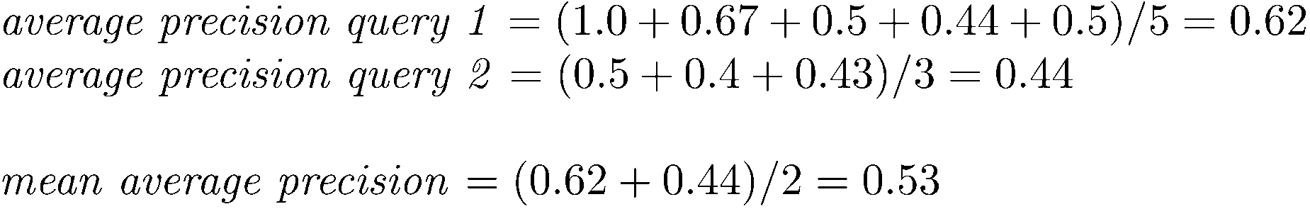
MAP

Slide 24
Mean average precision
If a relevant document never gets retrieved, we assume the precision corresponding to that relevant doc to be zero
MAP is macro-averaging: each query counts equally
Now perhaps most commonly used measure in research papers
Good for web search?
MAP assumes user is interested in finding many relevant documents for each query
MAP requires many relevance judgments in text collection

Slide 25
R-precision
R-precision is the precision after R-documents have been retrieved, where R is the number of relevant documents for the topic.

Slide 26
Beyond binary relevance

Slide 27
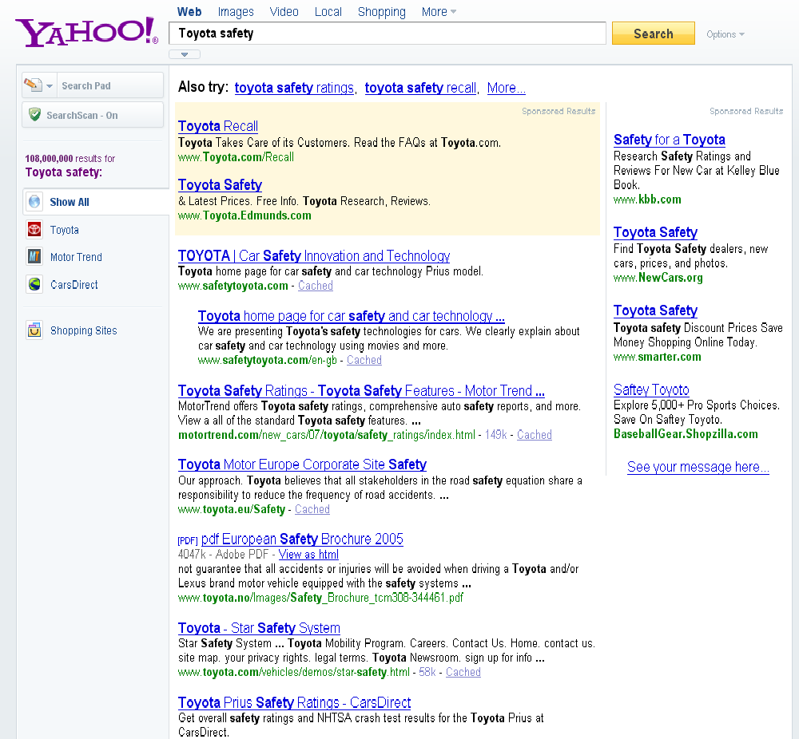
fair
fair
Good

Slide 28
Discounted Cumulative Gain
Popular measure for evaluating web search and related tasks
Two assumptions:
Highly relevant documents are more useful than marginally relevant documents
the lower the ranked position of a relevant document, the less useful it is for the user, since it is less likely to be examined

Slide 29
Discounted Cumulative Gain
Uses graded relevance as a measure of usefulness, or gain, from examining a document
Gain is accumulated starting at the top of the ranking and may be reduced, or discounted, at lower ranks
Typical discount is 1/log (rank)
With base 2, the discount at rank 4 is 1/2, and at rank 8 it is 1/3

Slide 30
Summarize a Ranking: DCG
What if relevance judgments are in a scale of [0,r]? r>2
Cumulative Gain (CG) at rank n
Let the ratings of the n documents be r₁, r₂, …r_{n} (in ranked order)
CG = r₁+r₂+…r_{n}
Discounted Cumulative Gain (DCG) at rank n
DCG = r₁ + r₂/log₂2 + r₃/log₂3 + … r_{n}/log₂n
We may use any base for the logarithm
Notes:
For rank positions above b, do not discount

Slide 31
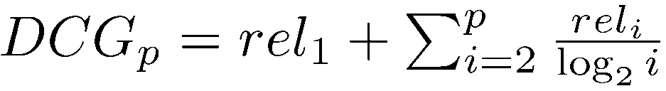
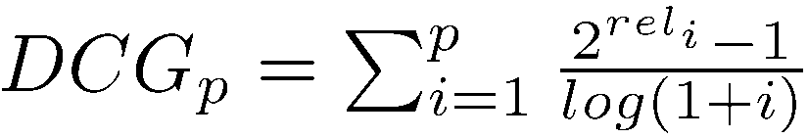
Discounted Cumulative Gain
DCG is the total gain accumulated at a particular rank p:
Alternative formulation:
used by some web search companies
emphasis on retrieving highly relevant documents

Slide 32
DCG Example
10 ranked documents judged on 0–3 relevance scale:
3, 2, 3, 0, 0, 1, 2, 2, 3, 0
discounted gain:
3, 2/1, 3/1.59, 0, 0, 1/2.59, 2/2.81, 2/3, 3/3.17, 0
= 3, 2, 1.89, 0, 0, 0.39, 0.71, 0.67, 0.95, 0
DCG:
3, 5, 6.89, 6.89, 6.89, 7.28, 7.99, 8.66, 9.61, 9.61
Notes:
Normalized DCG:
DCG values are often normalized by comparing the DCG at each rank with the DCG value for the perfect ranking
makes averaging easier for queries with different numbers of relevant documents

Slide 33
NDCG for summarizing rankings
Normalized Discounted Cumulative Gain (NDCG) at rank n
Normalize DCG at rank n by the DCG value at rank n of the ideal ranking
The ideal ranking would first return the documents with the highest relevance level, then the next highest relevance level, etc
Normalization useful for contrasting queries with varying numbers of relevant results
NDCG is now quite popular in evaluating Web search
Notes:
Perfect ranking:
3, 3, 3, 2, 2, 2, 1, 0, 0, 0
ideal DCG values:
3, 6, 7.89, 8.89, 9.75, 10.52, 10.88, 10.88, 10.88, 10
Actual DCG:
3, 5, 6.89, 6.89, 6.89, 7.28, 7.99, 8.66, 9.61, 9.61
NDCG values (divide actual by ideal):
1, 0.83, 0.87, 0.76, 0.71, 0.69, 0.73, 0.8, 0.88, 0.88
NDCG ≤ 1 at any rank position

Slide 34
NDCG - Example
4 documents: d₁, d₂, d₃, d₄
i | Ground Truth |  | Ranking Function₁ |  | Ranking Function₂
 | Document Order | r_{i} | Document Order | r_{i} | Document Order | r_{i}
1 | d4 | 2 | d3 | 2 | d3 | 2
2 | d3 | 2 | d4 | 2 | d2 | 1
3 | d2 | 1 | d2 | 1 | d4 | 2
4 | d1 | 0 | d1 | 0 | d1 | 0
 | NDCG_{GT}=1.00 |  | NDCG_{RF1}=1.00 |  | NDCG_{RF2}=0.9203

Slide 35
What if the results are not in a list?
Suppose there’s only one Relevant Document
Scenarios:
known-item search
navigational queries
looking for a fact
Search duration ~ Rank of the answer
measures a user’s effort

Slide 36
Mean Reciprocal Rank
Consider rank position, K, of first relevant doc
Could be – only clicked doc
Reciprocal Rank score =
MRR is the mean RR across multiple queries

Slide 37
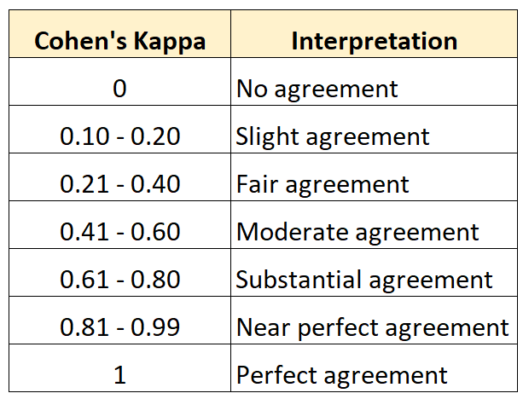
Accessing Relevance: Cohen’s Kappa Statistic
k = (p_{o} – p_{e}) / (1 – p_{e})
p_{o}: Relative observed agreement among raters
p_{e}: Hypothetical probability of chance agreement

Slide 38
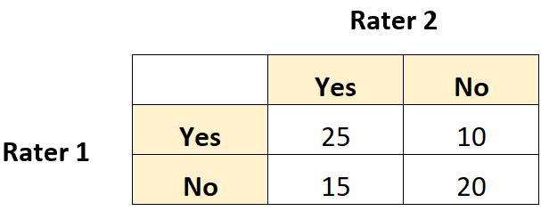
Calculate relative agreement (p_{o}) between raters.
p_{o} = (Both said Yes + Both said No) / (Total Ratings)

Slide 39
Calculate the hypothetical probability of chance agreement (p_{e}) between raters.
P(Yes)=(total number of times that Rater 1 said “Yes”)/ (the total number of responses)*(total number of times that Rater 2 said “Yes”/(the total number of responses)
P(No)=(total number of times that Rater 1 said “No”)/ (the total number of responses) *(the total number of times that Rater 2 said “No.”)/ (the total number of responses)
Pe=P(“Yes”)+P(“No”)

Slide 40
Calculate Cohen’s Kappa
k = (p_{o} – p_{e}) / (1 – p_{e})

Slide 41
Human judgments are
Expensive
Inconsistent
Between raters
Over time
Decay in value as documents/query mix evolves
Not always representative of “real users”
Rating vis-à-vis query, don’t know underlying need
May not understand meaning of terms, etc.
So – what alternatives do we have?

Slide 42
Using user Clicks

Slide 43
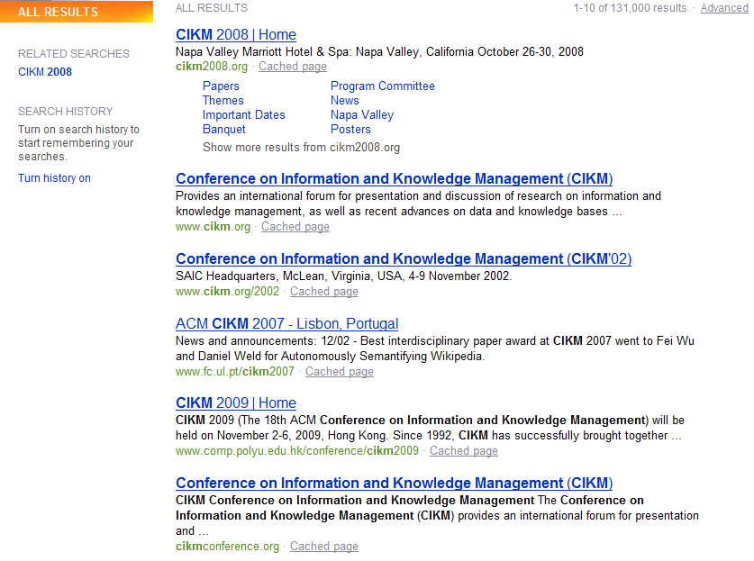
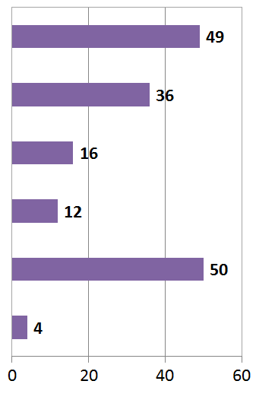
User Behavior
Search Results for “CIKM” (in 2009!)
# of clicks received

Slide 44
User Behavior
Adapt ranking to user clicks?
# of clicks received

Slide 45
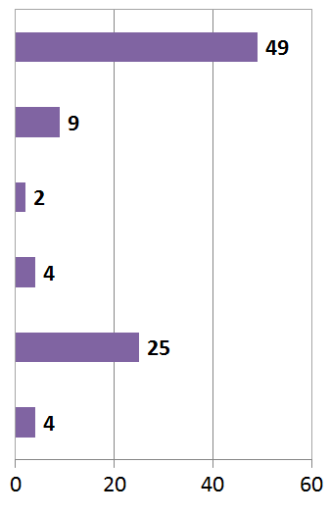

What do clicks tell us?
Tools needed for non-trivial cases
# of clicks received
Strong position bias, so absolute click rates unreliable

Slide 46
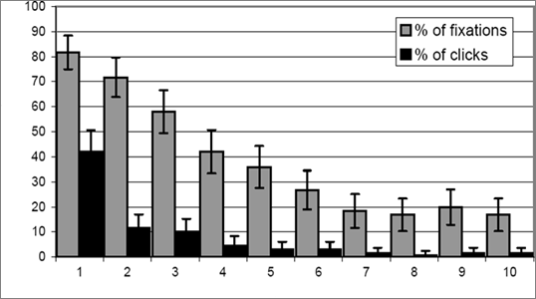
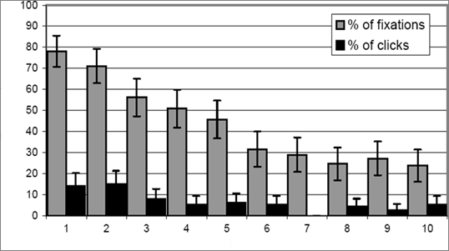
Click Position-bias
Higher positions receive more user attention (eye fixation) and clicks than lower positions.
This is true even in the extreme setting where the order of positions is reversed.
“Clicks are informative but biased”.
Percentage
Normal Position
Percentage
Reversed Impression
[Joachims+07]

Slide 47
Relative vs absolute ratings
User’s click
sequence
Hard to conclude Result1 > Result3
Probably can conclude Result3 > Result2

Slide 48
Evaluating pairwise relative ratings
Pairs of the form: DocA better than DocB for a query
Doesn’t mean that DocA relevant to query
Now, rather than assess a rank-ordering wrt per-doc relevance assessments …
Assess in terms of conformance with historical pairwise preferences recorded from user clicks
BUT!
Don’t learn and test on the same ranking algorithm
I.e., if you learn historical clicks from nozama and compare Sergey vs nozama on this history …

Slide 49
Comparing two rankings via clicks (Joachims 2002)
Query: [support vector machines]
Ranking A
Ranking B
Kernel machines
Kernel machines
SVM-light
SVMs
Lucent SVM demo
Intro to SVMs
Royal Holl. SVM
Archives of SVM
SVM software
SVM-light
SVM tutorial
SVM software

Slide 50
Interleave the two rankings
Kernel machines
Kernel machines
SVMs
This interleaving starts with B
SVM-light
Intro to SVMs
Lucent SVM demo
Archives of SVM
Royal Holl. SVM
SVM-light
…

Slide 51
Remove duplicate results
Kernel machines
Kernel machines
SVMs
SVM-light
Intro to SVMs
Lucent SVM demo
Archives of SVM
Royal Holl. SVM
SVM-light
…

Slide 52
Count user clicks
Kernel machines
A, B
Kernel machines
Clicks
SVMs
Ranking A: 3 Ranking B: 1
SVM-light
A
Intro to SVMs
Lucent SVM demo
A
Archives of SVM
Royal Holl. SVM
SVM-light
…

Slide 53
Interleaved ranking
Present interleaved ranking to users
Start randomly with ranking A or ranking B to even out presentation bias
Count clicks on results from A versus results from B
Better ranking will (on average) get more clicks

Slide 54
A/B testing at web search engines
Sec. 8.6.3
Purpose: Test a single innovation
Prerequisite: You have a large search engine up and running.
Have most users use old system
Divert a small proportion of traffic (e.g., 0.1%) to an experiment to evaluate an innovation
Interleaved experiment
Full page experiment

Slide 55
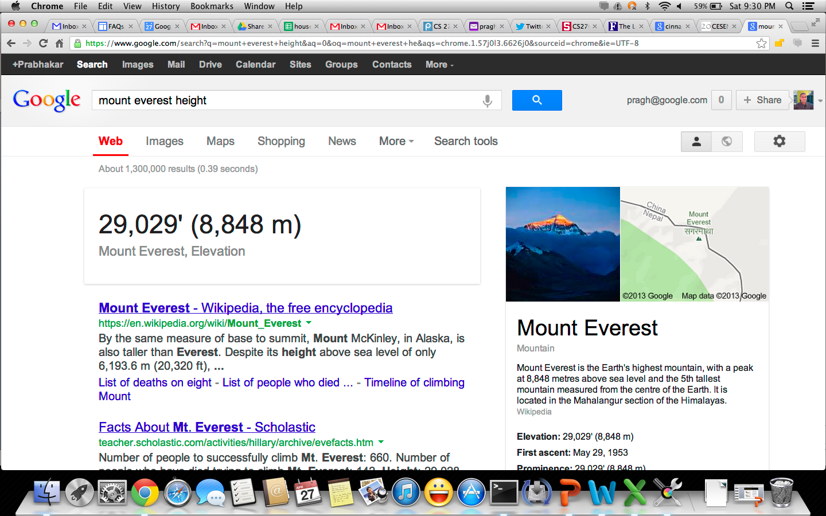
Facts/entities (what happens to clicks?)

Slide 56
Recap
Benchmarks consist of
Document collection
Query set
Assessment methodology
Assessment methodology can use raters, user clicks, or a combination
These get quantized into a goodness measure – Precision/NDCG etc.
Different engines/algorithms compared on a benchmark together with a goodness measure

Slide 57
User behavior
User behavior is an intriguing source of relevance data
Users make (somewhat) informed choices when they interact with search engines
Potentially a lot of data available in search logs
But there are significant caveats
User behavior data can be very noisy
Interpreting user behavior can be tricky
Spam can be a significant problem
Not all queries will have user behavior

